Slide 1
ABSTRACT ID: A3445 CATEGORY: Ongoing Clinical Trials
Results From The IMIGASTRIC Study: Minimally Invasive Approaches Compared With Open Gastrectomy On Surgical, Oncological And Clinical Outcomes
A propensity score-matched case-control analysis
Jacopo Desiderio, MD
Department of Digestive Surgery
St. Mary’s Hospital of Terni
University of Perugia, Italy

Slide 2
ABSTRACT ID: A3445 CATEGORY: Ongoing Clinical Trials
Results From The IMIGASTRIC Study: Minimally Invasive Approaches Compared With Open Gastrectomy On Surgical, Oncological And Clinical Outcomes
A propensity score-matched case-control analysis
Jacopo Desiderio, MD
Department of Digestive Surgery
St. Mary’s Hospital of Terni
University of Perugia, Italy
Notes:
Thank you Mr. Chairman. I would like to thank the Organizing Committee and his President that decided to give high visibility to our study. The IMIGASTRIC project is a multi-institutional study on gastric cancer developed to collect information on the surgical, clinical, and oncological features of patients undergoing gastrectomy with a robotic, laparoscopic, or open approach.

Slide 3
STUDYN DESIGN
OBJECTIVES
Develop a multi-institutional database on gastric cancer
Analyze surgical, clinical and oncological outcomes of Minimally Invasive Surgery
Compare Laparoscopic and Robotic approach with open surgery
www.imigastric.com
Notes:
The main objectives are to review data of gastric cancer patients, analyze outcomes of those underwent minimally invasive surgery and make a comparison with the open approach.

Slide 4
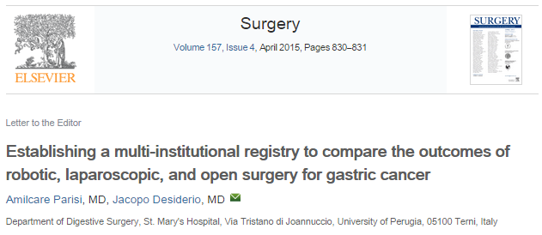
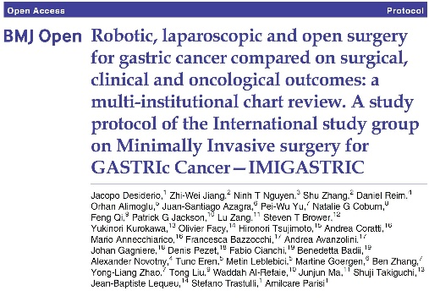
STUDYN DESIGN
TYPE OF STUDY
Observational Retrospective Cohort Study
NCT02325453
Three treatments arms
Patients treated with curative intent
Data from medical records and existing institutional databases
www.imigastric.com
Notes:
This is an ongoing multi-institutional observational retrospective cohort study comparing three treatment arms. A research group was first established in 2014 and after sharing a specific study protocol, data collection officially started at the end of 2015.

Slide 5
STUDYN DESIGN
GROUPS
LAPAROSCOPY
OPEN SURGERY
ROBOTIC SURGERY
Da Vinci robotic
surgical system
Traditional laparoscopic devices
Conventional surgical approach
www.imigastric.com
Notes:
We defined the following groups of comparison: Laparoscopic gastrectomy: patients underwent minimally invasive gastrectomy through traditional laparoscopic devices.
Robotic gastrectomy: with the assistance of the “Da Vinci” robotic surgical system.
Open gastrectomy: patients underwent traditional surgery.

Slide 6
STUDYN DESIGN
DATA COLLECTION
Patient demographics
Surgical procedure details
Tumor characteristics
Post-operative clinical findings
Post-operative complications
Follow-up details
www.imigastric.com
Notes:
Data entry, based on inclusion and exclusion criteria, has been organized into six specific areas: Patient characteristics, Surgical procedure details, Tumor characteristics, Data concerning the postoperative period, Surgical complications, Details of oncological follow-up

Slide 7
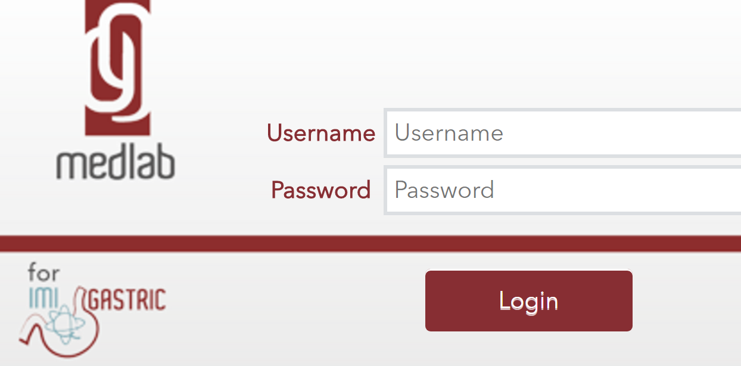
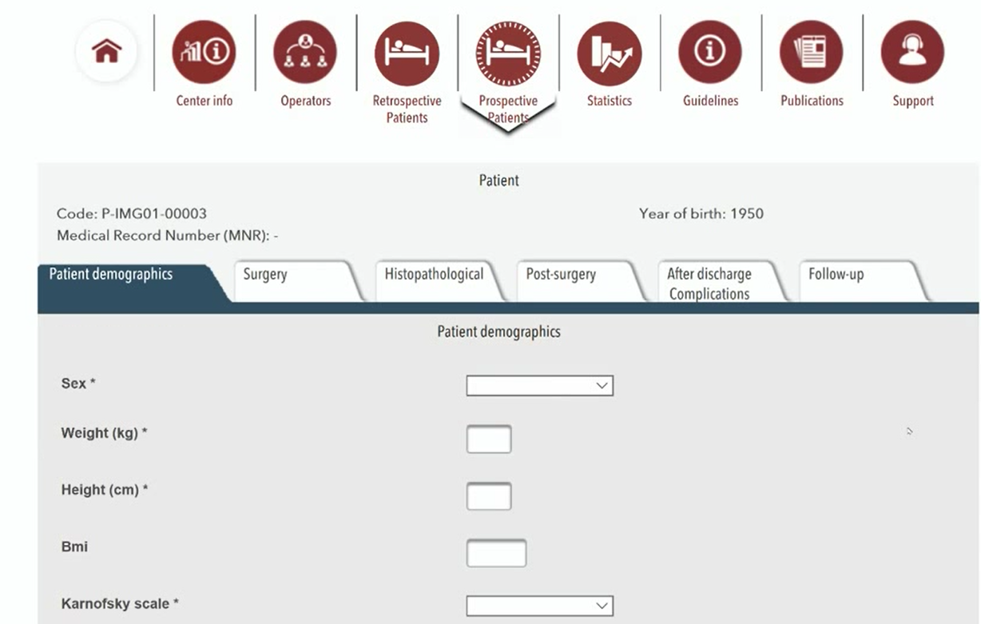
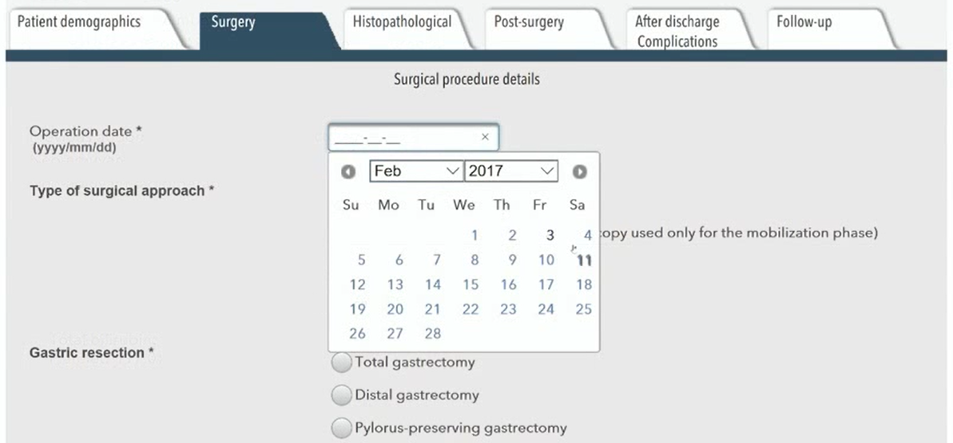
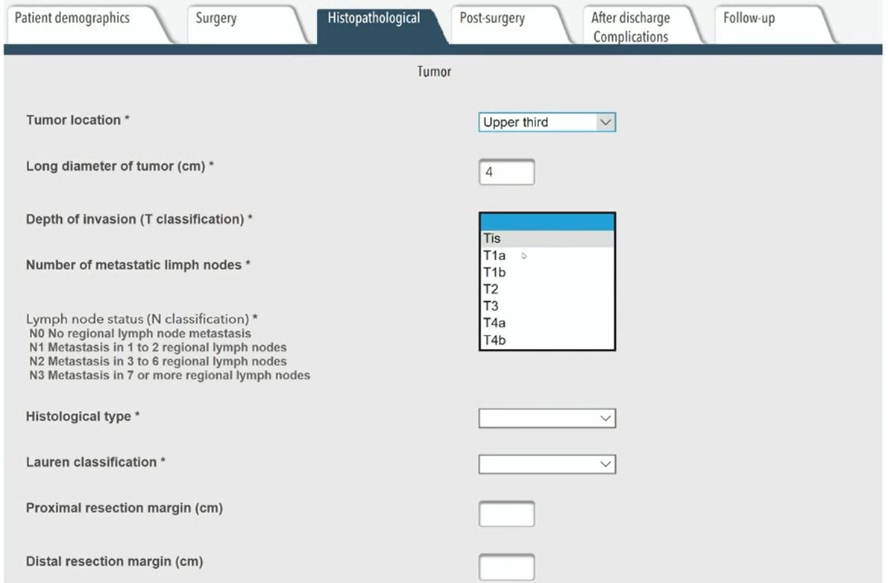
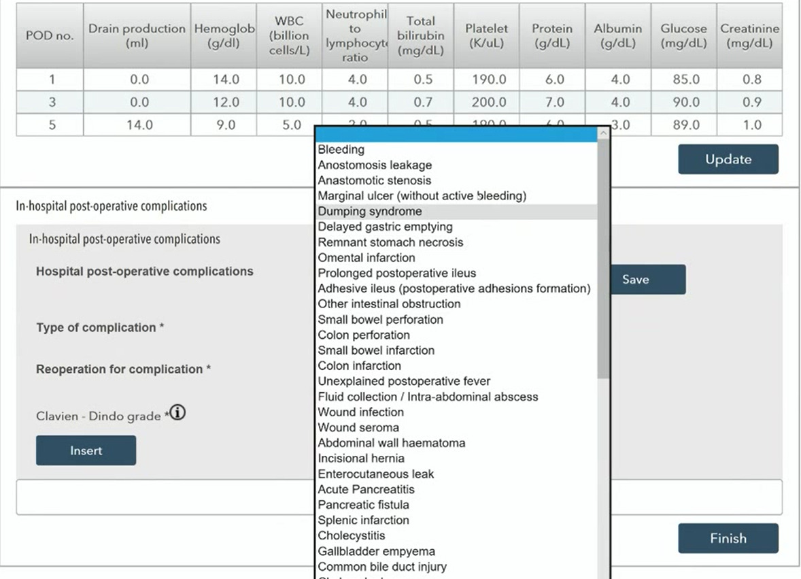
SOFTWARE TOOLS
www.imigastric.com
Notes:
A tailored Web-based software was developed to standardize data collection, expedite the creation of a shared database, and ensure the security of sensitive data. The purpose was to create an international registry with a high methodological quality. An IT instrument was created thanks to close cooperation with experts in software development. Among the main characteristics of the adopted software, there are: different levels of user profiles, each center has its own independent management, you can obtain statistics on your center, as well as on the overall database.

Slide 8
PROJECT UPDATE
CONTRIBUTION IN DATA ENTRY
(Number of patients up to April 2017)
Europe: 1282
North America: 126
Asia: 2460
________________
TOTAL No. 3868
Open: 1390
MIS: 2478
www.imigastric.com
Notes:
Almost 4000 cases to date have been entered in the registry. The number is increasing thanks to the great efforts of the investigators, who are working with perseverance and passion to increase the patient sample. 64% of entered cases are from Asia, but over 1400 cases were collected by Western Institutions. About 2500 patients underwent a MIS approach.

Slide 9
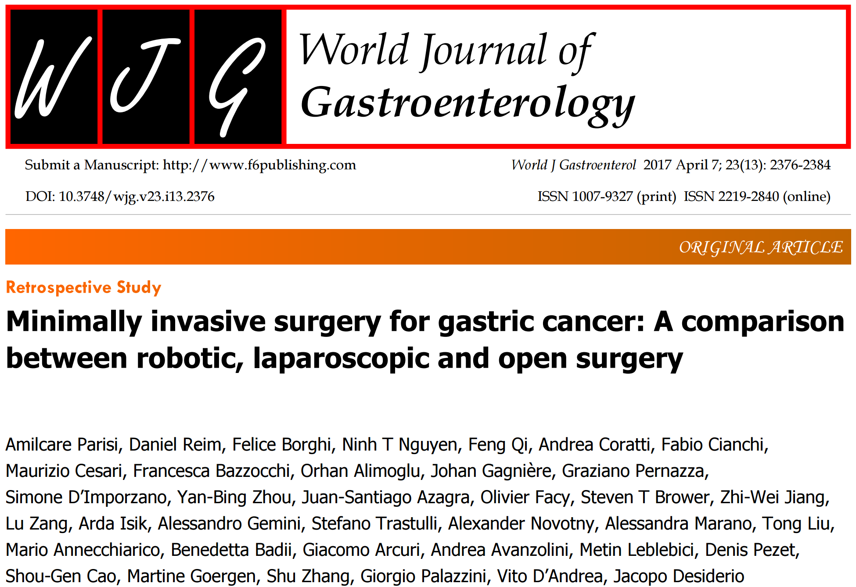
METHODS
PROPENSITY SCORE-MATCHED CASE-CONTROL STUDY
Data entered up to June 2016:
RG, LG and OG were 1:1:2 matched
TOTAL No. 1386
IBM SPSS Statistics V.23; R software version 3.1
Dichotomous variables: numbers and percentages
Continuous variables: mean and SD, median and IQR
Comparison: ANOVA, Pearson’s χ2 test, Fisher’s exact test
P < 0.05 statistically significant
www.imigastric.com
Notes:
In June 2016 we decided to perform a first study using data from the IMIGASTRIC database, containing at that time a total of 1386 cases.
It is a great pleasure to give here a presentation on this first work. In this report, we performed a comparison regarding operative results, postoperative recovery, and complications.

Slide 10
FLOWCHART OF THE STUDY
Total No. 1386
Eligibility Assessment
Laparoscopy No. 227
Robotic No. 222
Open No. 577
1026 patients selected for
full data extraction
PROPENSITY SCORE
Covariates: sex, age, comorbidities, BMI, stage of disease, type of gastrectomy
604 PATIENTS INCLUDED
after matching
LAPAROSCOPIC GROUP
No. 151
ROBOTIC
GROUP
No. 151
OPEN
GROUP
No. 302
www.imigastric.com
Notes:
This is the study’s flowchart. After the assessment of inclusion and exclusion criteria a total of 1026 patients were first selected. This sample underwent a matching analysis. Each patient’s propensity score was calculated by a multivariable logistic regression model using six covariates. Patients in the RG, LG and OG group were 1:1:2 matched by the closest propensity score on the logit scale. Finally, the matching analysis resulted in a total sample of 604 patients, 151 from RG group, 151 from LG group, 302 patients from OG group. The successful matching permitted to obtain a homogeneous distribution of all patient’s characteristics, surgeries performed and stage of the disease.

Slide 11
DATA ANALYSIS
PATIENTS CHARACTERISTICS
ROBOTIC | LAPAROSCOPY | OPEN
67.19 ± 13.10 | 65.82 ± 14.16 | 66.81 ± 12.11
24.58 ± 3.00 | 24.02 ± 2.22 | 24.33 ± 3.65
Age | P=0.14
Sex | P=0.26
BMI | P=0.31
ASA | P=0.18
Comorbidities | P=0.96
TUMOUR CHARACTERISTICS
 | ROBOTIC | LAPAROSCOPY | OPEN
Lower third | 84 (55.6%) | 76 (50.3%) | 153 (50.7%)
Middle third | 54 (35.8%) | 54 (35.8%) | 108 (35.8%)
Upper third | 13 (8.6%) | 21 (13.9%) | 41 (13.6%)
P=0.57
Notes:
As shown, no differences were found in all baseline patient characteristics and most of tumors were located in the lower third of the stomach.

Slide 12
DATA ANALYSIS
PATHOLOGY
 | ROBOTIC | LAPAROSCOPY | OPEN
0 | 4 (2.6%) | 4 (2.6%) | 19 (6.3%)
ⅠA | 54 (35.8%) | 54 (35.8%) | 76 (25.2%)
ⅠB | 27 (17.9%) | 27 (17.9%) | 48 (15.9%)
ⅡA | 14 (9.3%) | 14 (9.3%) | 55 (18.2%)
ⅡB | 14 (9.3%) | 14 (9.3%) | 28 (9.3%)
ⅢA | 12 (7.9%) | 12 (7.9%) | 24 (7.9%)
ⅢB | 17 (11.3%) | 17 (11.3%) | 34 (11.3%)
ⅢC | 9 (6.0%) | 9 (6.0%) | 18 (6.0%)
P=0.16
UNDIFFERENTIATED | 55 (36.4%) | 65 (43.0%) | 115 (38.1%)
P=0.46
Notes:
No significant differences were found in the pathological stage assessment and the proportion of patients with undifferentiated tumors was similar.

Slide 13
DATA ANALYSIS
SURGICAL PROCEDURES DETAILS
 | ROBOTIC | LAPAROSCOPY | OPEN
Distal | 111 (73.5) | 102 (67.5) | 205 (67.9)
Total | 40 (26.5) | 49 (32.5) | 97 (32.1)
P=0.42
 | ROBOTIC | LAPAROSCOPY | OPEN
Billroth Ⅰ/Ⅱ | 51 (33.8) | 31 (20.5) | 88 (29.1)
Roux-en-Y G-J | 60 (39.7) | 70 (46.4) | 117 (38.7)
Roux-en-Y E-J | 40 (26.5) | 50 (33.1) | 97 (32.1)
P=0.10
Notes:
All groups had a rate in favor of the distal gastrectomy with not statistically differences in reporting a D2 lymphadenectomy or regarding the type of reconstruction performed.

Slide 14
DATA ANALYSIS
SURGICAL OUTCOMES
ROBOTIC | LAPAROSCOPY | OPEN
365.44 ± 80.92 | 220.37 ± 91.89 | 198.67 ± 59.66
117.91 ± 68.11 | 95.93 ± 119.22 | 127.26 ± 79.50
OPERATIVE TIME (min) | P<0.001
EBL (mL) | P=0.002
RETRIEVED LNS (no.) | P=0.07
INTRAOP. COMPLICATIONS | P=0.9
INTRAOP. TRANSFUSIONS | P=0.56
RESIDUAL TUMOR (R) | P=0.59
27.78 ± 11.45 | 24.58 ± 13.56 | 25.82 ± 12.07
CONVERSION TO OPEN SURGERY
ROBOTIC | LAPAROSCOPY | P=0.5
7 (4.6%) | 8 (5.3%)
Notes:
The operative time was significantly longer in the RG than the other two groups. A statistical difference in favor of the OG was also observed when compared with the LG. A reduction in EBL resulted in favor of both of the minimally invasive approaches vs the OG and particularly slightly in favor of the LG when compared with the RG. Regarding the number of retrieved lymph nodes, MIS confirmed to guarantee an adequate number of nodes for pathological assessment with no significant difference with the open approach. No differences were found regarding intraoperative complications or the residual tumor status. The conversion rate was 5.3% in the LG and 4.6% in the RG with no significant difference.

Slide 15
DATA ANALYSIS
CLINICAL OUTCOMES
ROBOTIC | LAPAROSCOPY | OPEN
8.85 ± 5.82 | 9.07 ± 9.16 | 12.68 ± 5.88
1.42 ± 1.27 | 2.70 ± 1.51 | 2.36 ± 1.34
3.21 ± 2.49 | 4.12 ± 3.37 | 5.79 ± 3.30
4.23 ± 3.79 | 5.73 ± 7.00 | 8.36 ± 5.45
3.23 ± 1.33 | 3.75 ± 0.76 | 4.01 ± 1.05
6.05 ± 8.69 | 6.44 ± 4.61 | 8.50 ± 3.55
3.44 ± 1.78 | 2.90 ± 0.91 | 3.79 ± 1.48
HOSPITAL STAY | P<0.001
MOBILIZATION | P<0.001
LIQUID DIET | P<0.001
SOLID DIET | P<0.001
FIRST FLATUS | P<0.001
DRAIN REMOVAL | P<0.001
ANALGESIC USE | P<0.001
Notes:
A significantly shorter hospital stay was found in both of the MIS group vs the OG, without differences between the LG and RG.
All steps in the patients’ recovery status happened faster in both of the minimally invasive approaches than the open surgery. A small benefit was found to be significant in the minimally invasive groups vs the OG in intravenous analgesic discontinuation. The other outcomes showed a slight advantage in favor of minimally invasive surgery

Slide 16
DATA ANALYSIS
COMPLICATIONS
ROBOTIC | LAPAROSCOPY | OPEN
27 (17.9%) | 18 (11.9%) | 59 (19.5%)
PTs WITH COMPLICATIONS (no.) | P=0.13
TYPE | P=0.052
SURGICAL | P=0.29
NON-SURGICAL | P=0.17
CLAVIEN-DINDO GRADE | P=0.11
REOPERATION | P=0.38
 | ROBOTIC | LAPAROSCOPY | OPEN
I+II | 28 (93.3%) | 12 (63.2%) | 50 (73.5%)
IIIa | 0 (0.0%) | 2 (10.5%) | 3 (4.4%)
IIIb | 2 (5.7) | 5 (26.3) | 11 (16.2%)
IV | 0 (0.0%) | 0 (0.0%) | 4 (5.9%)
V | 0 (0%) | 0 (0%) | 0 (0%)
Notes:
A decrease in the number of patients experiencing postoperative complications was shown in both the robotic and laparoscopic group versus the open group, however this difference was not statistically significant. No differences were shown in surgical and non-surgical complications, as well as regarding the type of complication. Leakage, bleeding, and pancreatic fistula were the most observed surgical complications. Pneumonia and urinary were the most common medical complications. Majority of cases were low grade complications based on the Clavien Dindo classification (76.9%, overall). The number of patients requiring reoperation did not differ among the three groups.

Slide 17
DATA ANALYSIS
COMPLICATIONS
ANALYSIS OF LEAKAGE
ROBOTIC | LAPAROSCOPY | OPEN
4 (2.6%) | 4 (2.6%) | 11 (3.6%)
LEAK RATE | P=0.47
LEAK-RELATED REOPERATION | P=0.29
SITE OF LEAK | P=0.36
 | ROBOTIC | LAPAROSCOPY | OPEN
Esophagojejunostomy | 0 | 3 | 4
Gastroduodenostomy | 0 | 0 | 1
Gastrojejunostomy | 2 | 0 | 2
Duodenal stump | 2 | 1 | 4
Notes:
Anastomotic leakage was the most relevant surgical complication. Therefore, further analysis is reported. No differences in the overall leakage rate was shown between groups, as well as the distribution by different sites. In 37% of all cases, a new surgery was required, while 63% of cases were managed conservatively. The leak-related reoperation rate did not differ among the three groups.

Slide 18
CONCLUSIONS
MIS shows safety in ensuring oncological radicality
MIS leads to shorter hospital stays and the faster resumption of regular diet
Trend toward a decrease of complications is shown
www.imigastric.com
Notes:
Laparoscopic and robotic surgery, in this report, showed safety in ensuring oncological radicality with short hospitalization, benefits in all patients’ functional recovery steps and a lower trend in complications rates.

Slide 19
CONCLUSIONS
The IMIGASTRIC registry has the potential to become one of the largest databases on MIS for gastric cancer
Several subgroup analyses are possible
Data on survival are available and will be analyzed in the next report
www.imigastric.com
Notes:
The relevant work of all involved centers has allowed for the collection of an impressive amount of data. This first analysis has confirmed the potential for a large registry as a tool able to investigate the various aspects of minimally invasive procedures with the opportunity of developing several sub-studies.

Slide 20
FUTURE PERSPECTIVES
A new Interim data analysis after achieving 4000 patients
Subgroup analysis by specific subjects of interest
IMIGASTRIC software implementation
Evaluation of other fields of investigation
www.imigastric.com
Notes:
Future developments of the project involve: the implementation and updating of data analysis. Subgroup studies by specific subjects of interest: advanced gastric cancer, long-term survival. Software implementation adding new tools for real-time online statistics and data extraction. Promoting new studies on interesting fields of investigation.

Slide 21
FUTURE PERSPECTIVES
PROSPECTIVE TRIAL
IMIGASTRIC II
STUDY PROTOCOL IN PRESS
The Promoting Center has already received approval
Other Centers are joining the study
Trial registration number: NCT02325453
Newly identified subjects with gastric cancer
Enrollment is now opened
Expected recruitment period of 3 years
Oncological follow-up will be 5 years
www.imigastric.com
Notes:
During the last months, the Imigastric group has launched a prospective study with the aim to overcome the limitations of the present data collection. The ethics committee of the promoting center has already approved this study and patient enrollment is now open. Interested centers can join this prospective study.

Slide 22
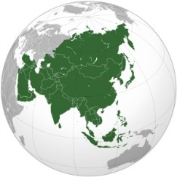
INVESTIGATORS
Department of Gastric Surgery, Fujian Medical University Union Hospital, Fuzhou, P.R. China
PI: Changming HUANG
Co-Investigator:Jian-xian LIN, Chaohui ZHENG
Department of General Surgery, The Affiliated Hospital of Qingdao University. Qingdao, P.R. China
PI: Yanbing ZHOU
Co-Investigator: Shougen CAO
Gastrointestinal Surgery, Tianjin Medical University General Hospital. Tianjin, P.R. China
PI: Feng QI
Co-Investigator: Tong LIU
Department of General Surgery, Jinling Hospital, Medical School, Nanjing University. Nanjing, P.R.China.
PI: Zhi-Wei JIANG
Co-Investigator: Shu ZHANG
Department of Surgery, Ruijin Hospital, Shanghai Jiaotong University, School of Medicine. Shanghai, P.R. China.
PI: Lu ZANG
Co-Investigator: Junjun MA
Department of General Surgery, Third Military Medical University Southwest Hospital. Chongqing, P.R. China.
PI: Pei-Wu YU
Co-Investigators: Ben ZHANG
Department of General Surgery, School of Medicine, Istanbul Medeniyet University. Istanbul, Turkey.
PI: Orhan Alimoglu
Co-Investigator: Metin Leblebici, Ibrahim Ali Ozemir
Notes:
I would like to thank all the investigators and institutions involved in the IMIGASTRIC project and the project manager, Dr. Parisi. All of them have made great efforts to start the study and continue data entry.

Slide 23
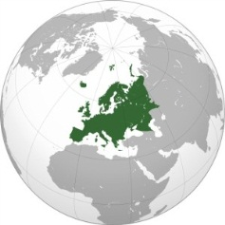
INVESTIGATORS
Department of Digestive Surgery, St. Mary’s Hospital, University of Perugia. Terni, Italy.
PI: Amilcare Parisi
Co-Investigators: Jacopo Desiderio, Stefano Trastulli, Alessandro Gemini
Chirurgische Klinik und Poliklinik, Klinikum Rechts der Isar der Technischen Universität München. München, Germany.
PI: Daniel Reim
Co-Investigators: Alexander Novotny
Division of Oncological and Robotic Surgery, Department of Oncology, Careggi University Hospital. Florence, Italy.
PI: Andrea Coratti
Co-Investigators: Mario Annecchiarico
Unité des Maladies de l’Appareil Digestif et Endocrine (UMADE), Centre Hospitalier de Luxembourg. Luxembourg.
PI: Juan-Santiago Azagra
Co-Investigators: Martine Goergen
Service de chirurgie digestive et cancérologique CHU Bocage. Dijon, France.
PI: Olivier Facy
Co-Investigators: Jean-Baptiste Lequeu
Department of General Surgery, Division of General, Gastroenterologic and Minimally Invasive Surgery, G.B.Morgagni Hospital. Forlì. Italy.
PI: Francesca Bazzocchi
Co-Investigator: Andrea Avanzolini
Digestive and Hepatobiliary Surgery Department. University of Auvergne, University Hospital Estaing. Clermont-Ferrand, France.
PI: Johan Gagniere
Co-investigators: Denis Pezet, Olivier Antomarchi

Slide 24
INVESTIGATORS
Unit of minimally invasive and endocrine surgery, Center of oncologic minimally invasive surgery (COMIS), Careggi University hospital. Florence, Italy.
PI: Fabio Cianchi
Co-Investigators: Benedetta Badii
Esophageal Surgery Unit, Tuscany Regional Referral Center for the Diagnosis and Treatment of Esophageal Disease, Medical University of Pisa. Pisa, Italy.
PI: Simone D’Imporzano
Department of General Surgery, A.S.O. Santa Croce e Carle. Cuneo, Italy.
PI: Felice Borghi
Co-investigators: Alessandra Marano
Minimally Invasive and Robotic Surgery Unit, San Giovanni Addolorata Hospital. Rome, Italy.
PI: Graziano Pernazza
Co-investigators: Stefano Mattacchione
Department of General Surgery, Hospital of Città di Castello, USL1 Umbria. Città di Castello, Italy.
PI: Maurizio Cesari
Co-investigator: Giacomo Arcuri
Department of Surgery, Division of Gastrointestinal Surgery, University of California, Irvine Medical Center. Orange CA, USA.
PI: Ninh T Nguyen
Department of Surgical Oncology and HPB Surgery, Englewood Hospital and Medical Center. Englewood NJ, USA.
PI: Steven T. Brower
Division of General Surgery, Sunnybrook Health Sciences Centre. Toronto, Canada.
PI: Natalie G. Coburn

Slide 25
INFORMATION
www.imigastric.com
ACKNOWLEDGEMENTS
JOIN THE STUDY
No profit cooperation
IT solutions
Web manager
Graphic designer
Edoardo Desiderio
Valentina Betti
Notes:
You can obtain further information by visiting the study website: www.imigastric.com, where a form to contact the organizing secretariat and the coordinating staff is available.

